Slide 1
Traffic sign detection system
19BCE1499
19BCE1668
19BCE1643

Slide 2
Abstract
The system is going to detect the traffic sign given(web app/local application) and gives back the meaning of that traffic sign
The system is going to be trained using Convolution Neural Network [A deep learning algo ] to get a fair amount of accuracy
As of now we have decided to use dataset from Kaggle which is quite famous
And also depending on the progress we will try to add extra features and will update in further reviews

Slide 3
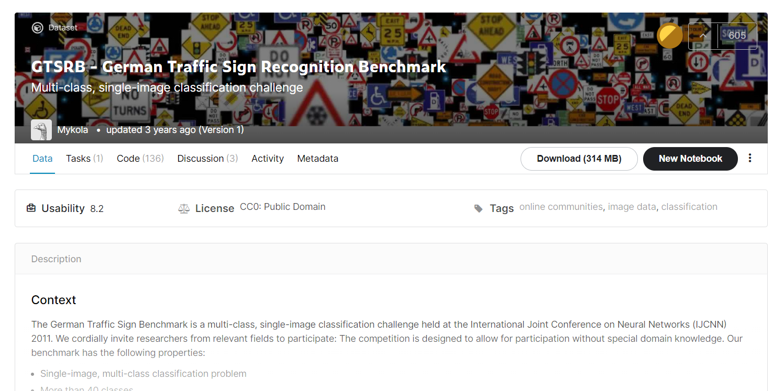
GTSRB DATASET

Slide 4
Dataset
The following datset has more than 50000 images and 40 different signs and the dataset provider has already classified the dataset based on it’s sign
The datset size is around 300mb
And the dataset is already divided as training and testing files

Slide 5
Research paper
The research paper we referenced is from research scholars from Dalian University China
https://ieeexplore.ieee.org/stamp/stamp.jsp?tp=&arnumber=8698449
They have also used the same GTSRB dataset
They were able to achieve around 75-95% accuracy depending on epoch value
They used their university hardware to train and they were able to achieve 95% accurate system after the training time took them more than 3hrs
They also observed that different class of images in dataset was not uniform and the accuracy also varied for different signs

